Slide 1
Acreage Estimation and Uncertainty Quantification for New York State
MPS in Applied Statistics and Data Science Capstone Project
By Tony Yik-Hau Au (ya293), Wenlin Huang (wh539), Sirui Cao (sc3554), Yuheng Shen (ys2393), Yiyou Jin (yj583)

Slide 2
Project Overview
Motivation & objective
Data & feature engineering
Modeling & Evaluation
Summary
Area for improvement

Slide 3
Motivation
US farmland in New York State has been declining over time
Farm operations face rising costs and financial pressure
Uncertainty in agricultural land use affects future food supply
Forecasting acreage helps improve planning and decision-making

Slide 4
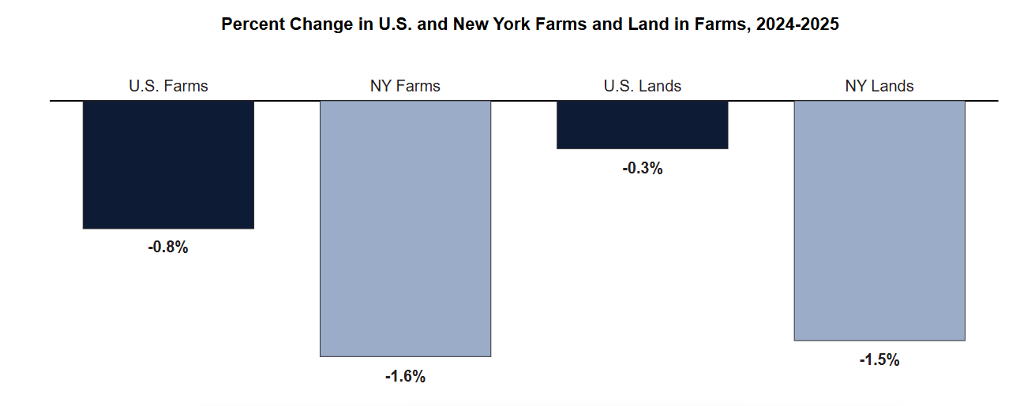
Motivation
Decline in farmland area

Slide 5
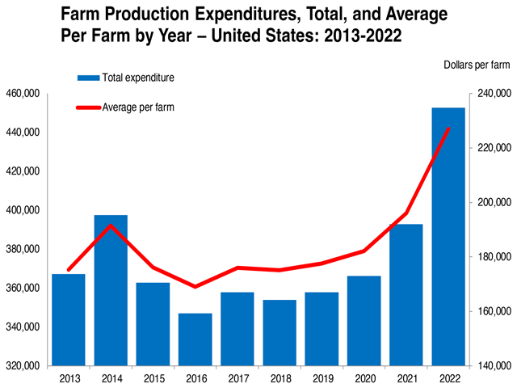
Motivation
Increasing farm production expenditures

Slide 6
Objective
Utilize historical crop spatial, weather and soil data
Develop a predictive model to forecast crop-specific acreage at the county level in New York State
Predict future acreage trends across crops and regions
Support data-driven decision making for farmers and policymakers

Slide 7
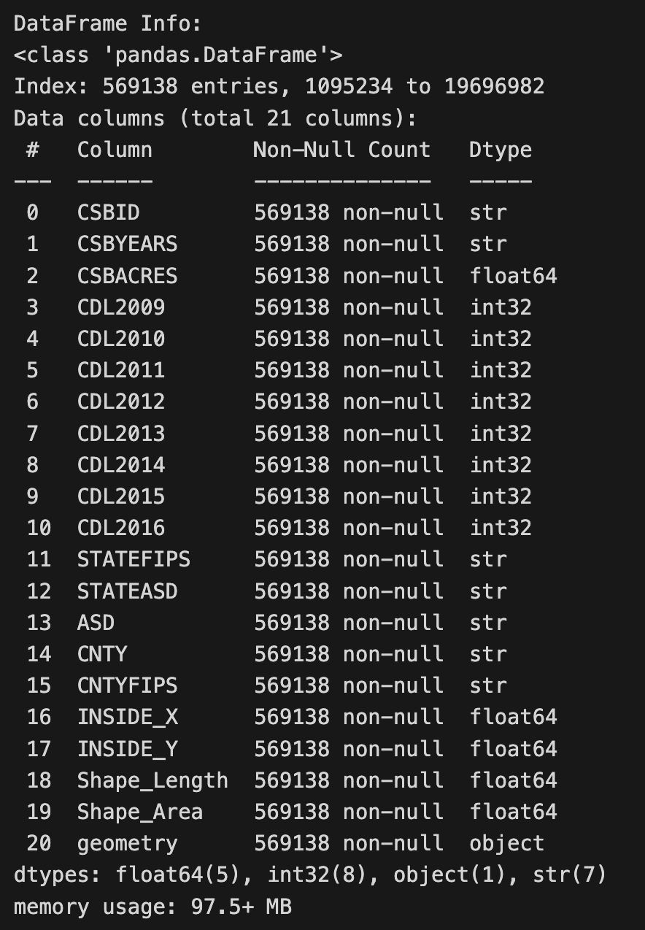
Data - CSB (Crop Sequence Boundaries)
A satellite-derived dataset across the contiguous U.S. on agriculture
Year: 2008-2024 (Annual)
Column: (polygon level)
Field-level crop rotations
Crop type
Acreage (in CDL)
Geometric information (county, state, longitude and latitude)
The data is grouped and merged in a wide format. (1,553,005 polygons)
The coding logic of the item is obtained from USDA website.

Slide 8
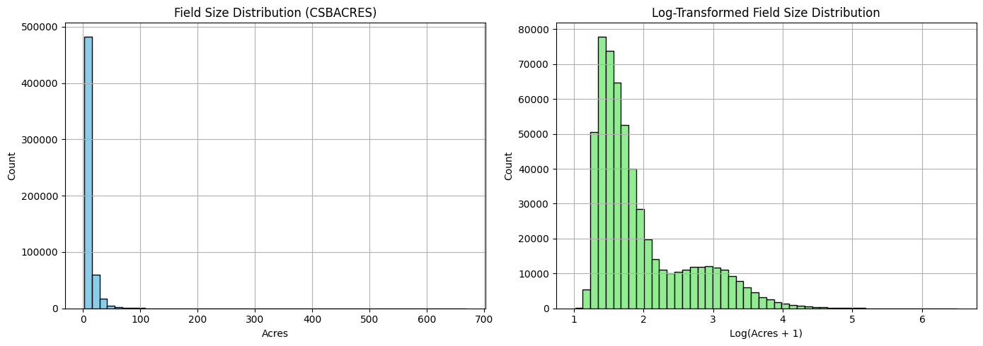
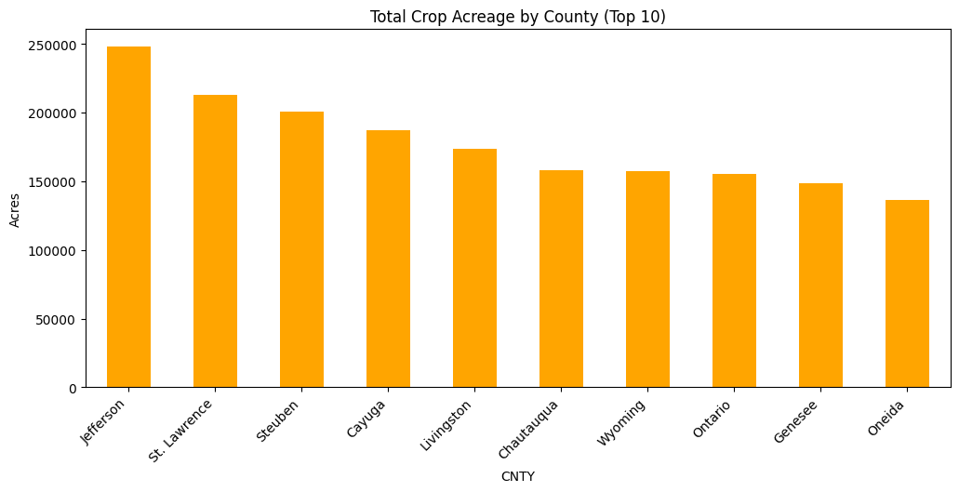
Data - Acreage Distribution
Heavy right skewed
Fat Right tail
Balanced across County
Skewness: raw: 6.9 vs log-transformed: 1.4

Slide 9
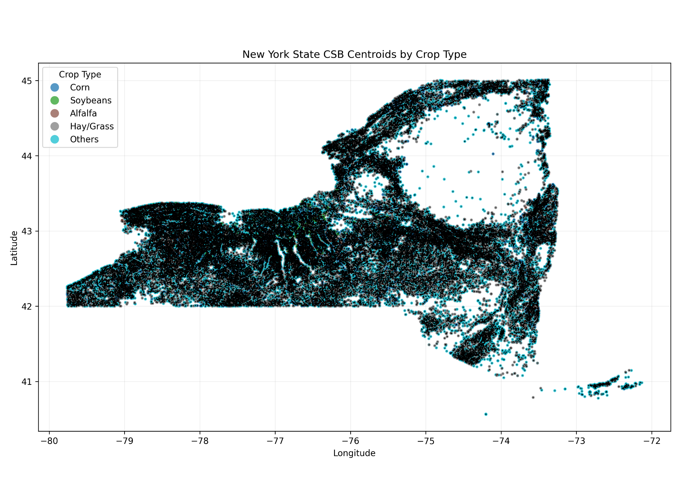
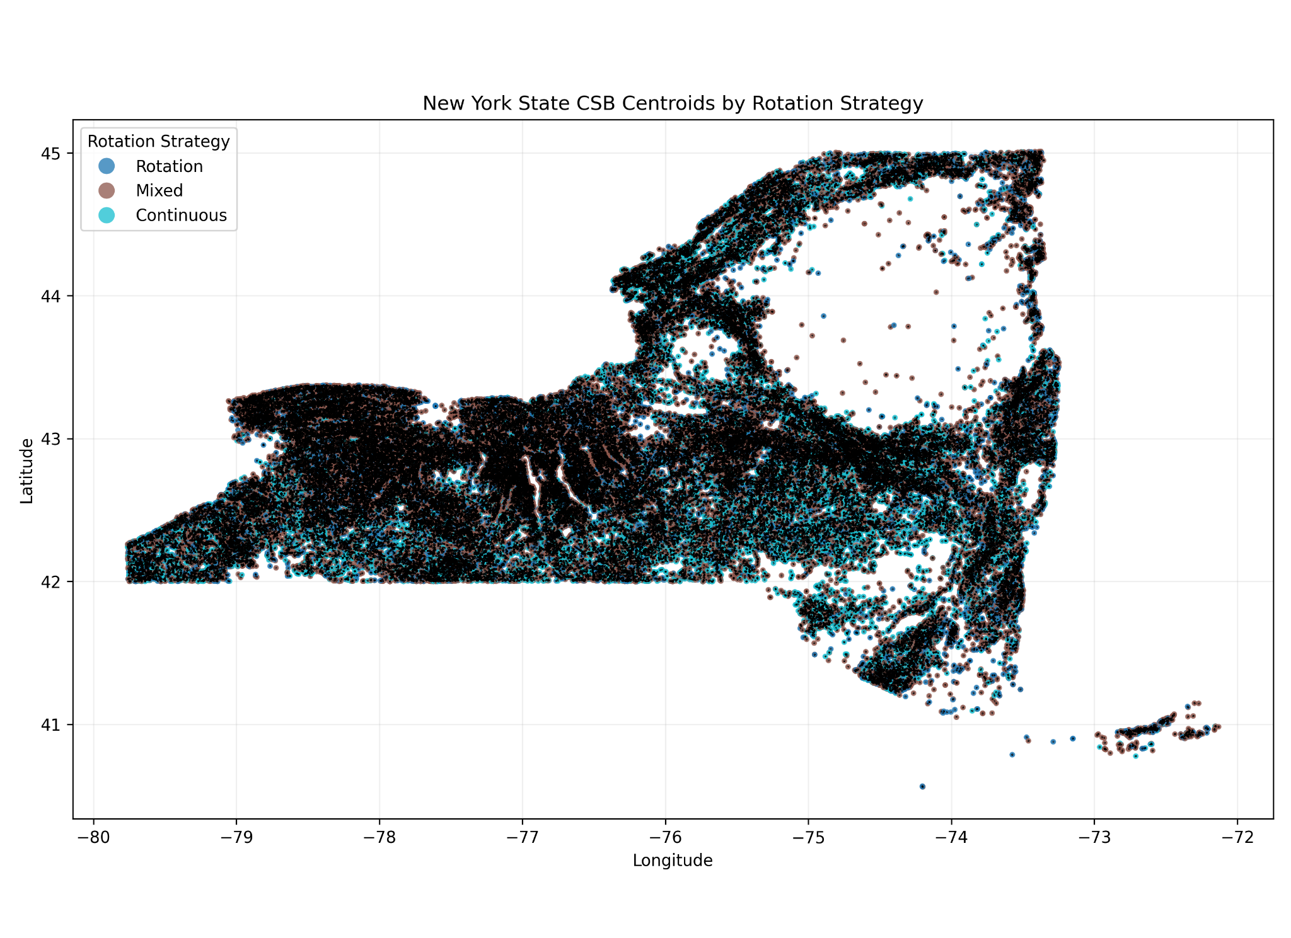
Data - Geometric Data
The CSB dataset captured the polygon data by specifying their longitude and latitude.
The data is in parquet format to store the geometric label

Slide 10
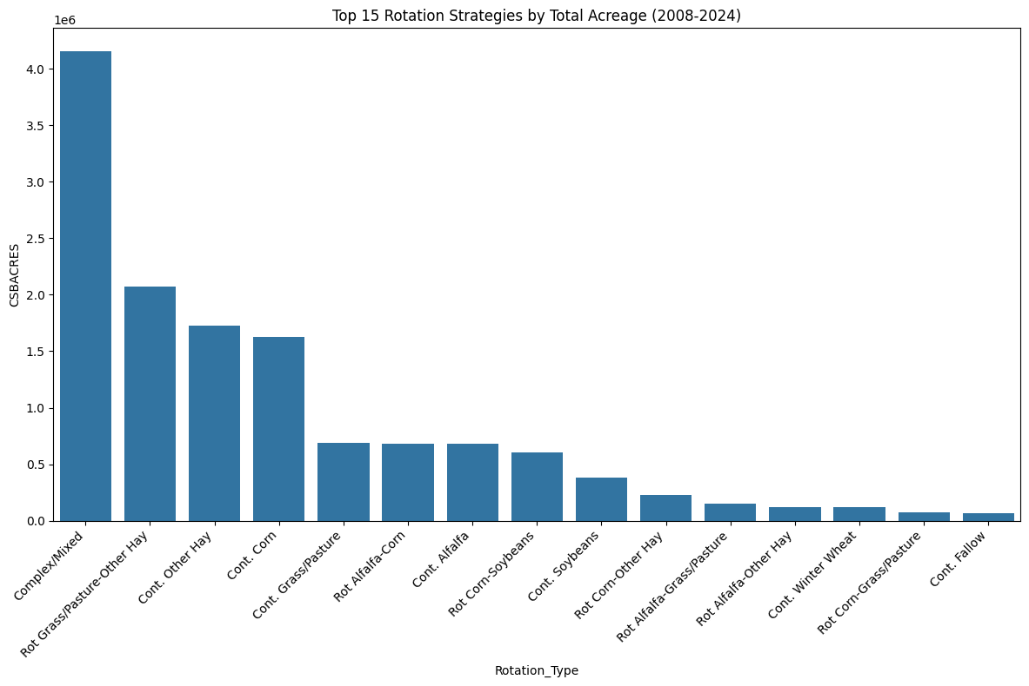
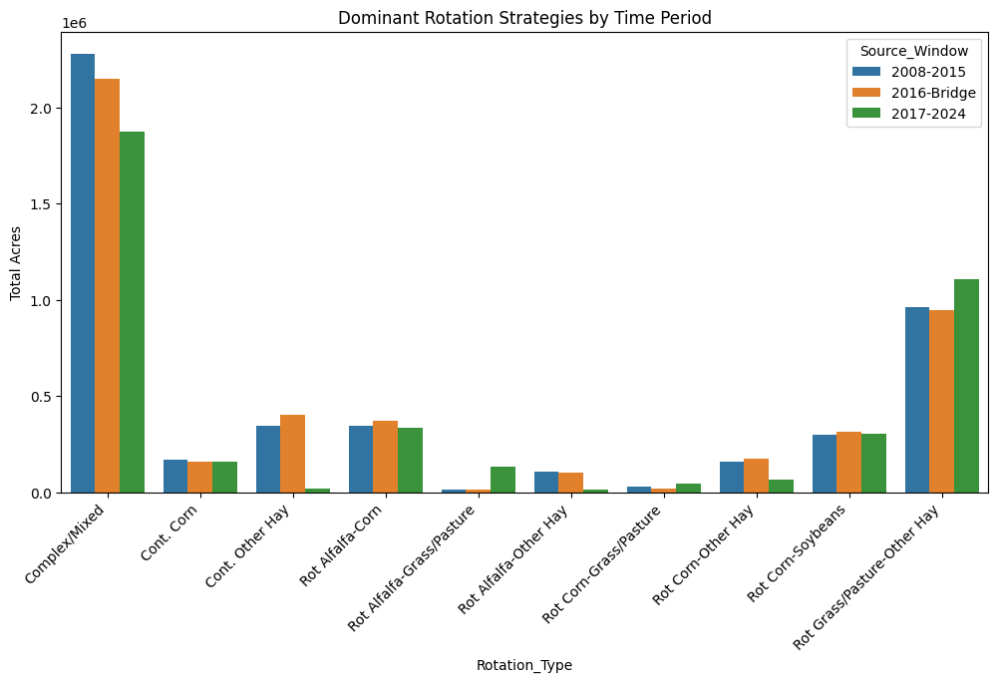
Data - Rotational Strategy
The rotational strategies spanned large dimensions of column
We decided to group the strategy type to simply the model and balance the data
Potential issue: smoothed out the trend and specific strategy feature

Slide 11
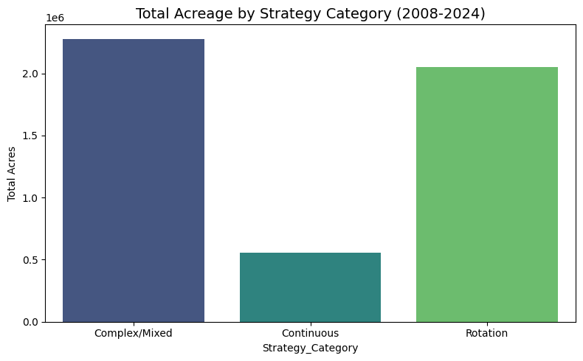

Data - Class Imbalance
We observed a class imbalance issue for the plant strategy in the CSB data in terms of the total acreage, but the class is balanced in polygon level

Slide 12
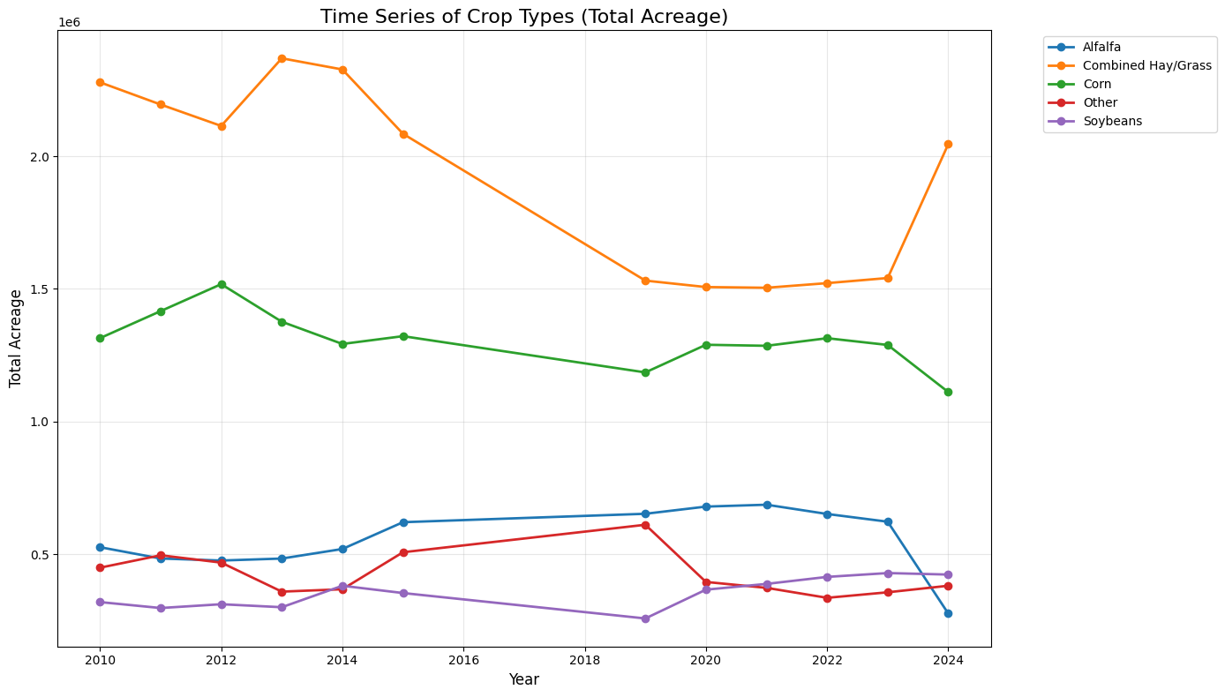
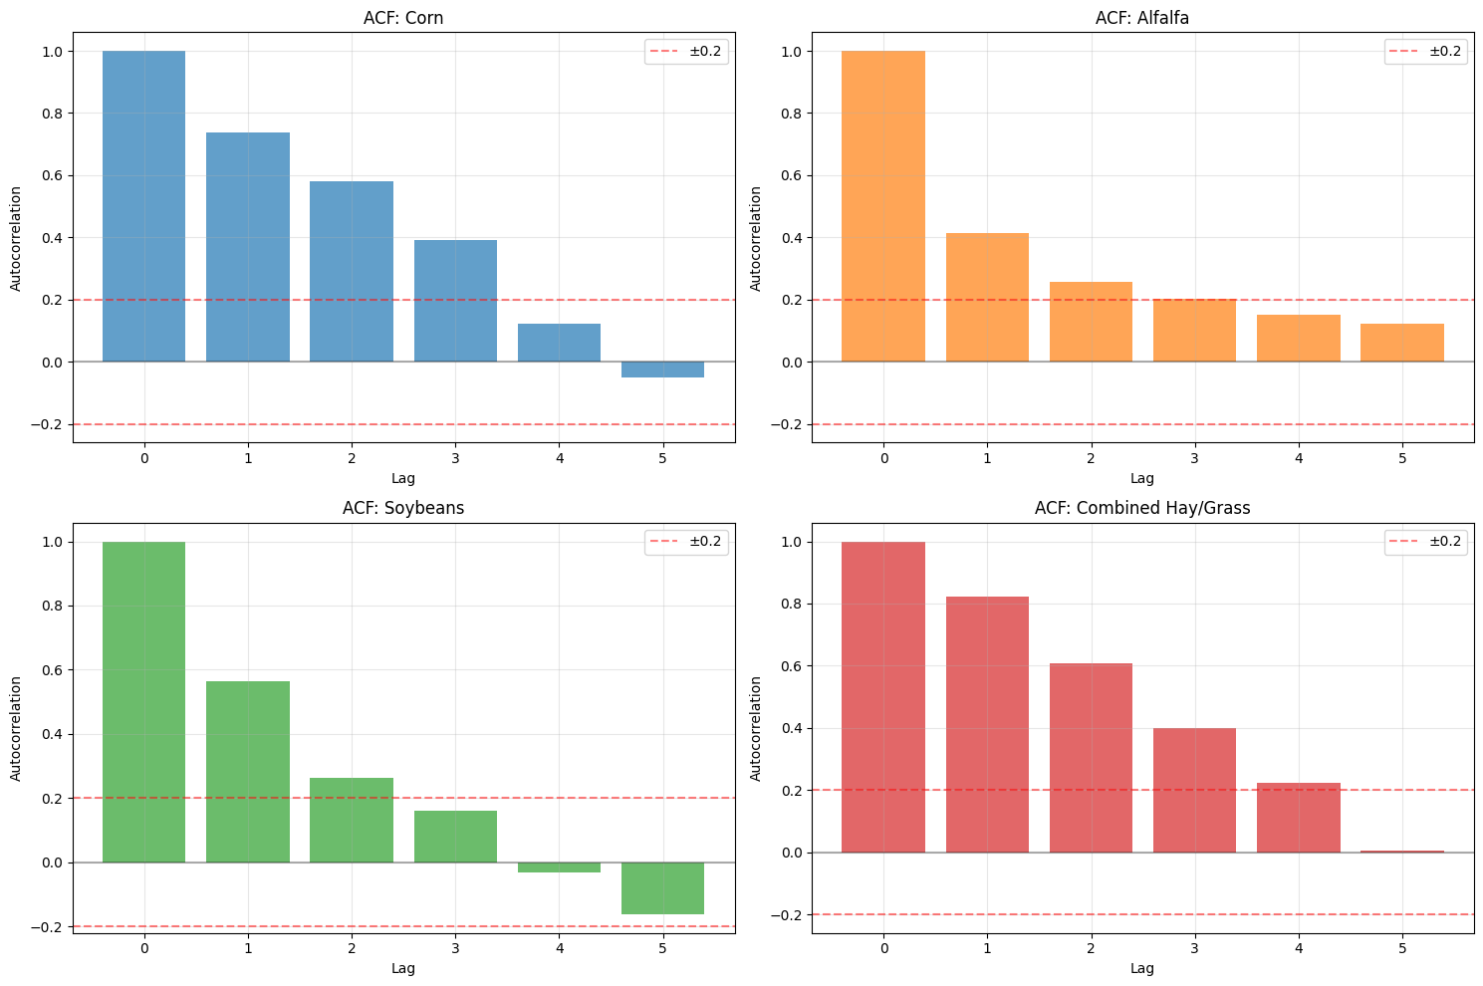
Data - Autocorrelation
Acreage exhibited the autocorrelation according to the ACF plot
Acreage per crop type

Slide 13
Data - Weather Data
-a panel of county-level weekly weather observations, containing detailed temperature, precipitation, growing degree days, and aridity measures along with their deviations from historical norms and prior periods.
variables:
avgt (Average temperature) — Mean air temperature over the specified period (°F).
mint (Minimum temperature) — Lowest recorded air temperature during the period (°F).
totr (Total precipitation) — Cumulative precipitation (rain/snow equivalent) over the period.
arid_acc (Accumulated aridity index) — Measure of dryness based on precipitation relative to atmospheric demand; higher values indicate drier conditions.
gdd_b10 (Growing Degree Days, base 10°F) — Heat accumulation above 10°F used to estimate crop development.
gdd_b44 (Growing Degree Days, base 44°F) — Heat accumulation above 44°F used for modeling crop growth stages.

Slide 14
Data - Soil Data
USDA gSSURGO provides detailed soil properties, including slope, water table depth, water storage capacity, bedrock depth, and ponding frequency.
Variables:
slopegradwta (Average slope (%) )
wtdepannmin (Annual minimum depth to water table )
wtdepaprjumin (Spring (Apr–Jun) water table depth )
aws0100wta (Available water (0–100 cm) )
aws050wta (Available water (0–50 cm) )
brockdepmin (Depth to bedrock )
pondfreqprs (Ponding frequency )

Slide 15
Modeling Methodology
Goal: Predict the Acreage level with regression model
Planting Strategy Classification Model:
Feature extraction
Generate label for regression model
Acreage Regression (Linear):
Regress the log transformed acreage on the features
Verify the selected features’ forecastability
Non-Linear Model:
Retrain the model using tree-based model

Slide 16
Feature Selection - Train/test Split
Timeline split with 2022 as the cutoff,
Since the data is not i.i.d. we assume the more recent data reflect more validation power
Training set: 2008-2022 (~88%)
Validation set: 2023-2024 (~12%)

Slide 17
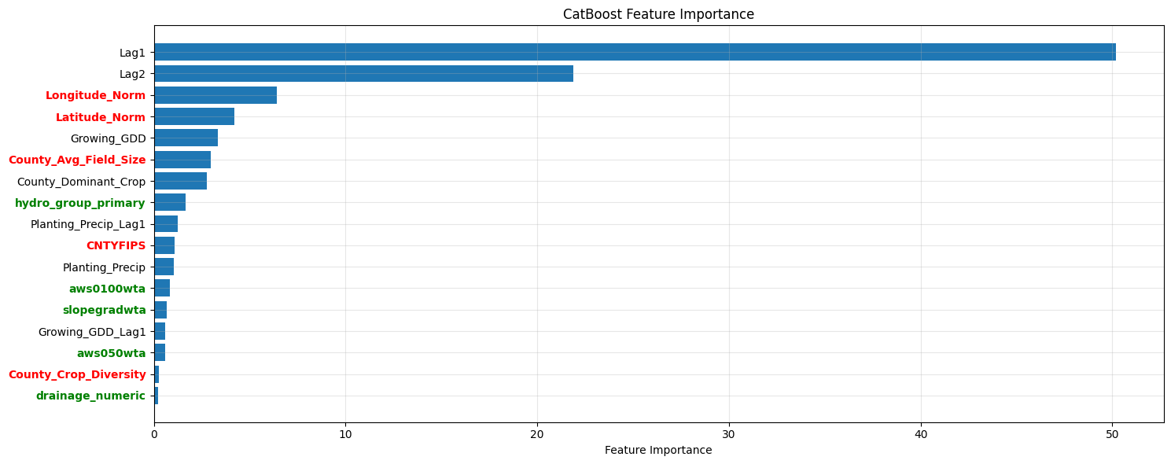
Classification Model - Catboost
Goal: 1) Generate polygon level label 2) feature selection
We selected CatBoosting for three advantages:
Robust accuracy (vs KNN)
Training efficiency (vs LSTM)
Model’s built-in feature importance served as the feature selection

Slide 18
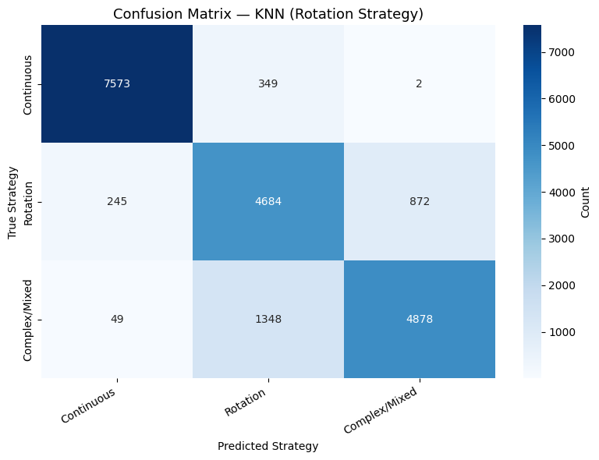
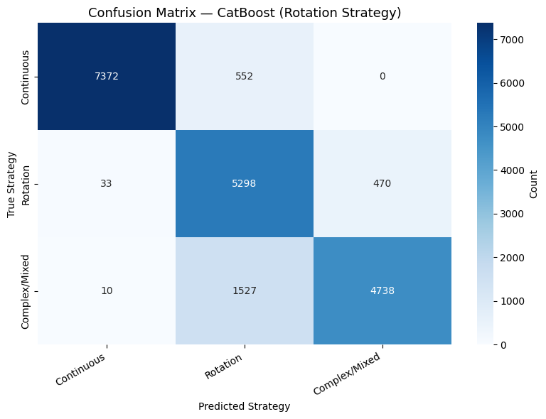
Classification Model - Catboost VS KNN
We noticed Catboost is slightly better than KNN
(Confusion matrix)
True Continuous: F1 (~96.12% vs ~95.92%)
True Rotation: F1 (~80.41% vs ~76.90%)
True Complex/Mixed: F1 (~82.52% vs ~81.12%)

Slide 19
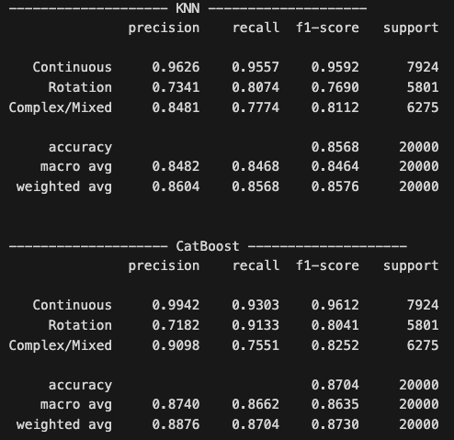
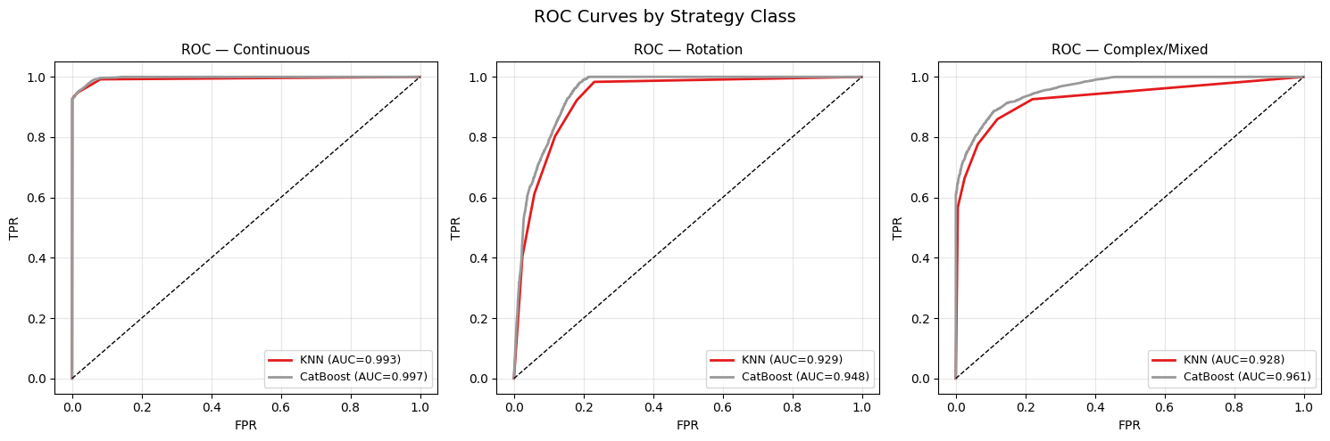
Classification Model - Catboost VS KNN
Goal: 1) Generate polygon level label 2) feature selection
accuracy (~87.0% vs ~85.7%)
precision — macro (~87.40% vs ~84.82%)
recall — macro (~86.62% vs ~84.68%)
F1 — macro (~86.35% vs ~84.64%)
ROC AUC — macro (~96.87% vs ~94.99%)

Slide 20
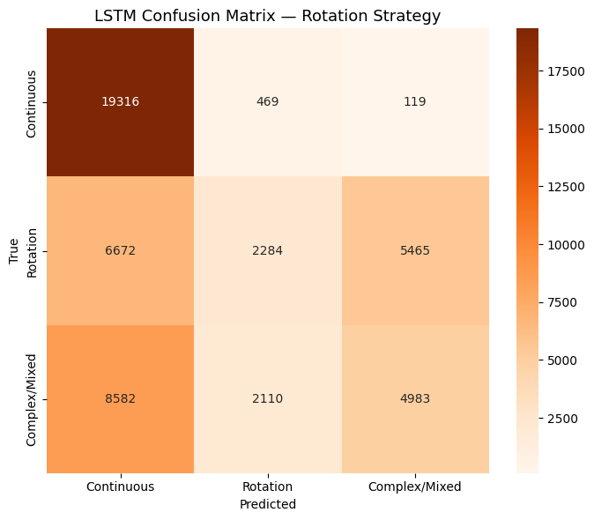
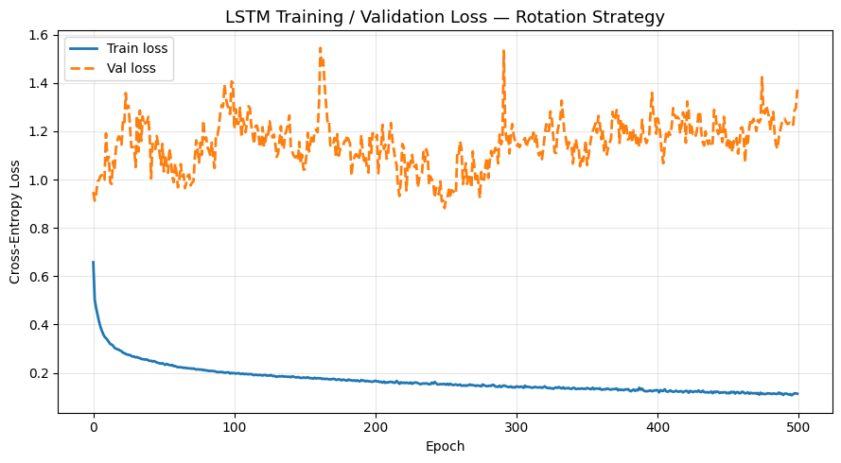
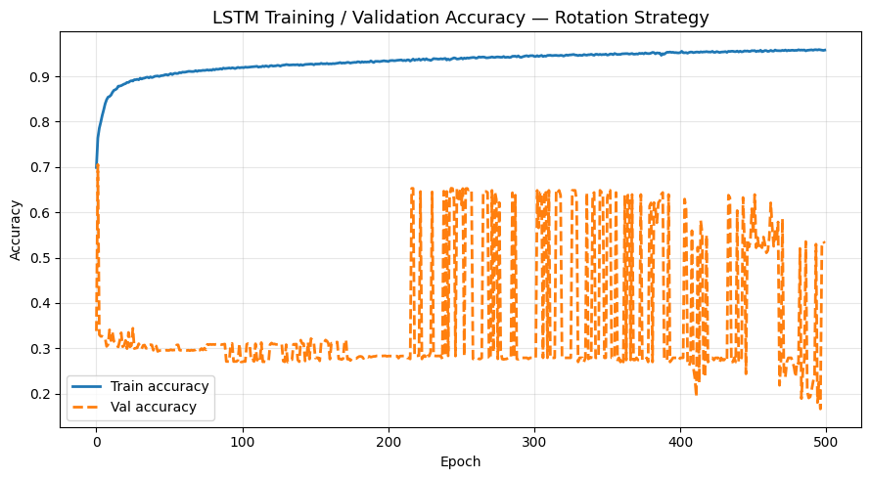
Classification Model - Deep Learning
We trained LSTM model for classification
LSTM specification:
Hidden layer = 2 (since simple model yields good result)
# Epoch: 500 (due to computational constraints)
Sample size: 50000 (cpu crashed beyond this level)
Batch size: 64; Optimizer: Adam
Loss: Entropy; drop_out: False
Lstm tends to memorize instead of generalize
We prefer simple tree-based model over a deep model

Slide 21
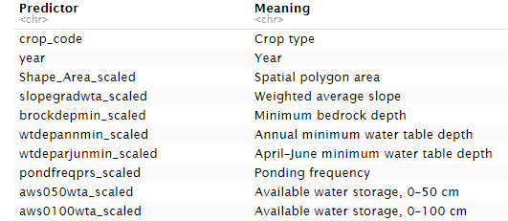
Baseline MLR Model
Goal: Build an interpretable baseline model for crop acreage prediction
Response variable: log(1 + acreage_area_proxy)
Predictors included:
Crop type and year
Soil features
Weather variables
County-level rotation strategy features

Slide 22
Model Performance
Metric Value
RMSE 1.574
MAE 1.218
R² 0.653
Adjusted R² 0.649
MSE on original acreage scale 1.24 × 10¹⁵
Interpretation: The model explains about 65% of the variation in log-transformed acreage. The log-scale RMSE is 1.574 .The original-scale MSE is large because acreage values are large and squared errors amplify large prediction gaps.

Slide 23
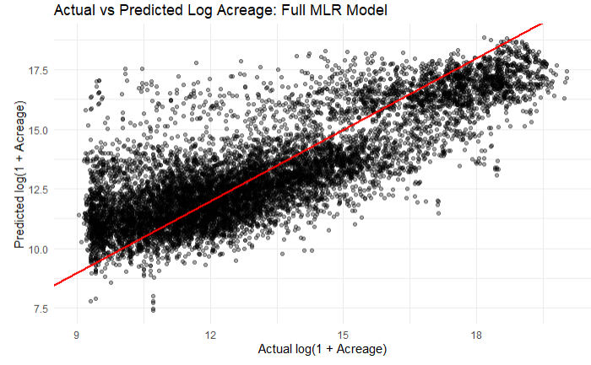
Actual vs Predicted Log Acreage
Main observations:
Predictions follow the general increasing trend.
Many points are close to the 45-degree reference line.
The spread is still large, especially in middle and high acreage ranges.
Interpretation: MLR captures broad acreage patterns but misses some detailed variation

Slide 24
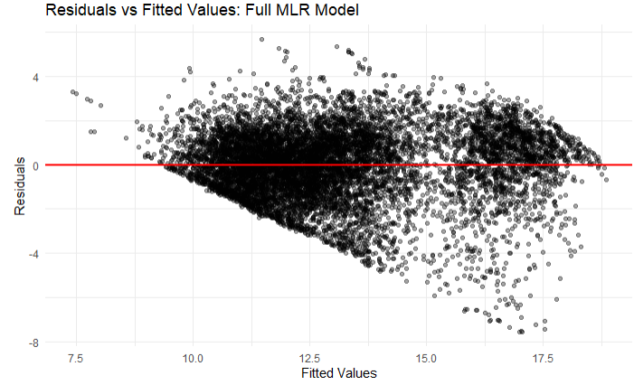
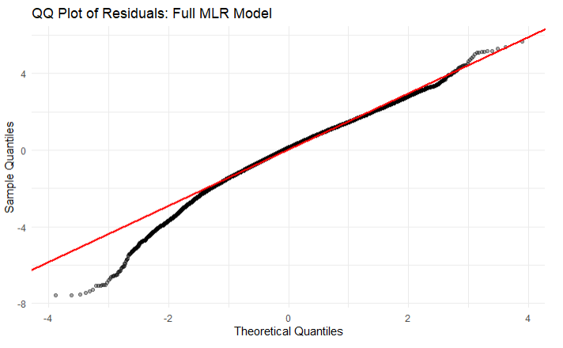
Model Diagnostics
Residual diagnostics show model limitations:
Residuals are not randomly scattered.
Error spread increases at higher fitted values.
QQ plot shows tail deviations.
Some extreme acreage cases are not well captured.
Implication:
Heteroskedasticity.
The model overpredicts acreage for some observations.
These diagnostics suggest that crop acreage is likely affected by nonlinear relationships or interaction effects that a standard linear model cannot fully capture.

Slide 25
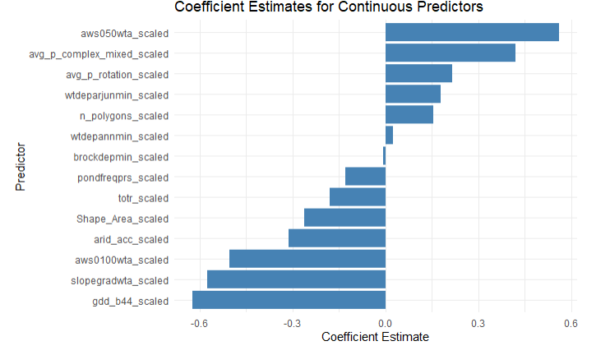
Coefficient Insights
Stronger positive associations:
aws050wta (available water storage in the top 50 cm of soil)
avg_p_complex_mixed (average probability of complex or mixed planting strategy)
Stronger negative associations:
gdd_b44 (growing degree days above base 44°F)
slopegradwta (weighted average land slope)
arid_acc (aridity accumulation index)

Slide 26
Takeaway from Initial MLR
What this baseline tells us:
Soil, weather, crop, and rotation features explain meaningful acreage variation.
Rotation strategy features add useful management-pattern information.
MLR is interpretable but limited.
Residual patterns suggest nonlinear or interaction effects.
Next step:
This motivates the next modeling stage, where more flexible models can better capture nonlinear relationships and interaction effects.

Slide 27
Random Forest Regression
Preprocess data: Load merged dataset, drop missing values, define predictors (exclude target and IDs)
Prepare per crop: Filter by crop, log-transform acreage, split into train/test (80/20)
Train model: Fit RandomForestRegressor (100 trees) for each crop
Evaluate: Compute test R-squared and RMSE
Interpret & output: Extract feature importance, rank models, and save results

Slide 28
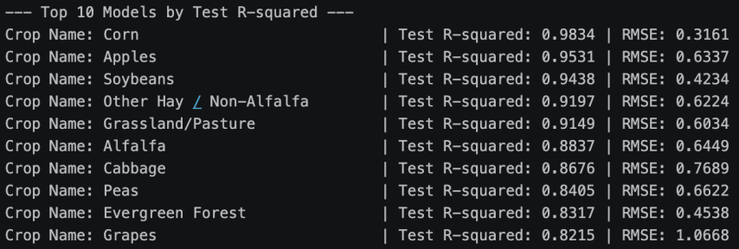
Predictive accuracy
Very high predictive performance across crops: The top Random Forest models achieve test R-squared values between 0.82 and 0.98, meaning the predictors explain 82%–98% of the variation in crop acreage. For example, Corn has test R-squared=0..9834, indicating extremely accurate predictions.

Slide 29
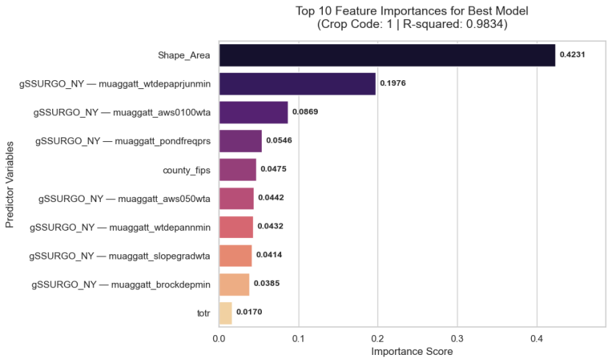
Feature Importance
Soil and geographic factors are the most influential predictors: For the best-performing model (Crop Code 1), the most important variable is Shape_Area (importance ≈ 0.423), followed by several soil characteristics such as water table depth, available water storage, and slope. These results suggest that land characteristics strongly influence crop acreage allocation.
Weather variables play a smaller role in this model: Although weather variables were included in the predictors, their importance scores are relatively lower (e.g., totr ≈ 0.017). This suggests that soil properties and land area may be more important determinants of acreage for this crop than short-term weather conditions.

Slide 30
Uncertainty Quantification
Method: Use out-of-bag (OOB) residuals from Random Forest to estimate uncertainty without retraining
Residual distribution: Compute empirical distribution of OOB residuals (prediction errors)
Prediction intervals: Construct intervals by adding/subtracting residual quantiles (e.g., 2.5% and 97.5%) to point predictions
Evaluation metrics: Assess uncertainty using coverage (≈95% target) and interval width
Outcome: Produces well-calibrated, low-width prediction intervals with near-nominal coverage

Slide 31
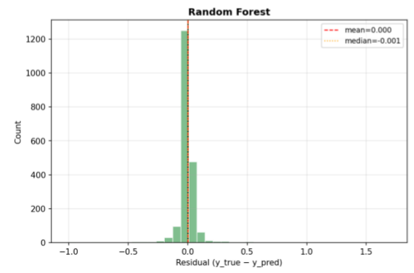
Uncertainty Quantification
The residual distributions clearly show that Random Forest provides unbiased, low-variance predictions.

Slide 32
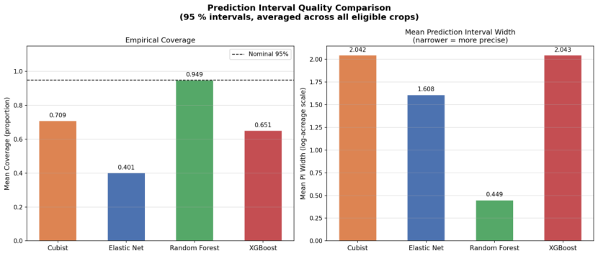
Random Forest Result
Random Forest provides well-calibrated prediction intervals with near-nominal coverage (94.9%) and the narrowest widths, indicating both reliability and precision.

Slide 33
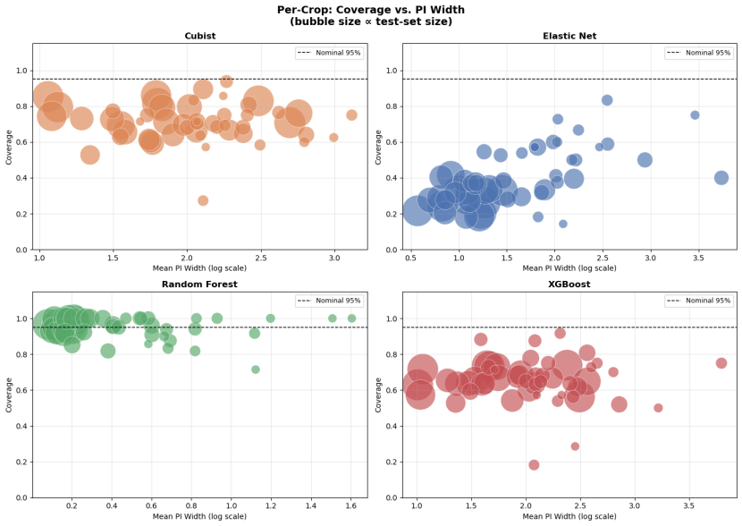
Random Forest Result
Random Forest consistently delivers well-calibrated and precise prediction intervals across all crops.

Slide 34
Summary
Random Forest regression achieves high predictive accuracy and low uncertainty by capturing nonlinear patterns through ensemble learning, yielding strong out-of-sample performance (high test R-squared, low RMSE). Its use of OOB residuals enables efficient construction of prediction intervals with near-nominal coverage and narrow widths, indicating precise and well-calibrated uncertainty estimates.

Slide 35
Key Findings
Pipeline: Multi-stage feature engineering integrating crop sequence history, weather, soil and spatial data
Key insight: Agriculture is highly autocorrelated and environmentally dependent
Crop classification: CatBoost chosen for interpretability (87% accuracy); LSTM achieves 91.92% but at cost of transparency
Acreage Estimation: Baseline MLR explains ~65% of variance, motivating the shift the nonlinear models. Random Forest achieves R² up to 0.98, providing unbiased low-variance predictions

Slide 36
Area For Improvement
Data Limitations
CSB annual data smooths out monthly seasonality
County-level aggregation loses field-level granularity
Model Limitations
Deep learning limited to 50K samples (full dataset: 5.9M)
CNN/RNN struggles with crop type prediction
Random Forest trained independently per crop type
Future Directions
Satellite imagery & Vegetation Index
Transformer/GNN architectures
Unified multi-output model for cross-crop dependencies
Conformal prediction for uncertainty quantification

Slide 37
Acknowledgements/Thanks
We would like to thank our advisors for their guidance and support throughout this project:
Luca Sartore, Ph.D. NISS Contractor (Senior Research Fellow), U.S. Department of Agriculture
David Ruppert, Ph.D. Andrew Schultz Jr. Professor of Engineering and Professor of Statistics and Data Science at Cornell University

Slide 38
Appendix
reference:
https://www.osc.ny.gov/reports/new-york-farms-and-farmland-decrease-higher-rate-nationally-2025
https://www.dtnpf.com/agriculture/web/ag/crops/article/2023/07/31/farmers-know-production-costs-higher

